Slide 1
Adaptive Slow Motion for Videos
Semester Project
Loïc Barben
Supervisor : Boris Neubert
Professor : Mark Pauly

Slide 2
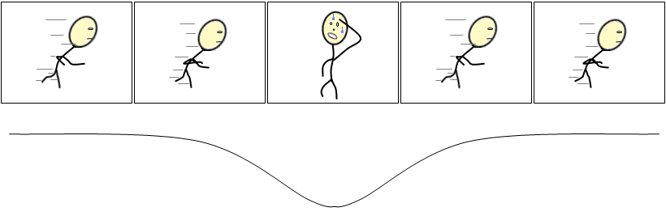
Introduction
Videos have dynamism
Dynamism : speed of objects or camera
Goal : adapt video play time to the dynamism of the scene
motion
time

Slide 3
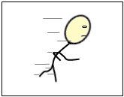
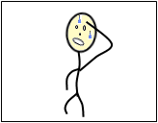
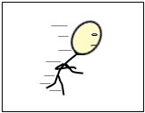
Introduction
Boring

Slide 4
Introduction
Boring

Slide 5
Introduction
Boring
Boring

Slide 6
Introduction
Less boring
Less boring

Slide 7
Plan
Approaches and the one chosen
Implementation of my solution
Results

Slide 8
Approaches
Use Point Trajectories
Use Object Segmentation
Own solution : Adaptive Clustering

Slide 9
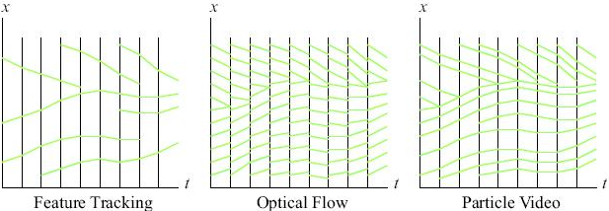
Approach
→ Particle Video*
Or Long-Range Motion Estimation Using Point Trajectories
* SAND, P., AND TELLER, S. J. 2006. Particle video: Long-range
motion estimation using point trajectories. In CVPR (2), IEEE Computer Society, 2195–2202.

Slide 10
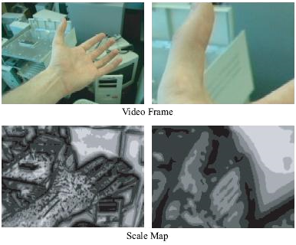
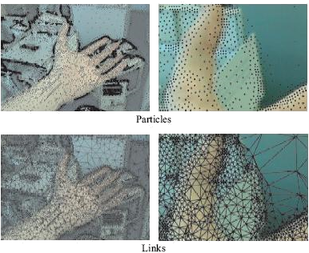
Approach
→ Particle Video
1
2
3
4

Slide 11
Approach
→ Particle Video
Video
7 sec, 492x360
9 sec, 960x540
Output size
897 MB
936 MB
Tracked Points
5h10
> 8h
10 sec, 1280x720
23 sec, 640x360
1.43 GB
> 729 MB
Computation time
97’051
7h46
> 8h
171’524
122’590
102’325
Format : [start frame] [end frame] [p.x p.y] [p.x p.y] …

Slide 12

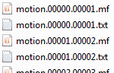
Approach
→ Particle Video
Video input (7 sec)
→ About 5h of computation at 3.7Ghz
171’524 tracked points

Slide 13
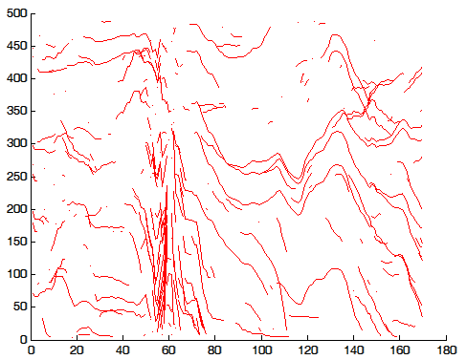
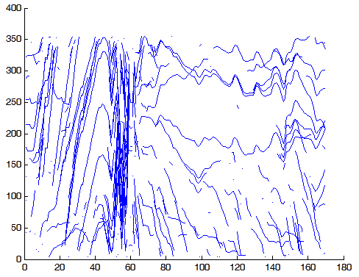
Approach
→ Particle Video
Uniform sampling (250/171’052)
Y : width
Y : height
X : frames number 1-169

Slide 14
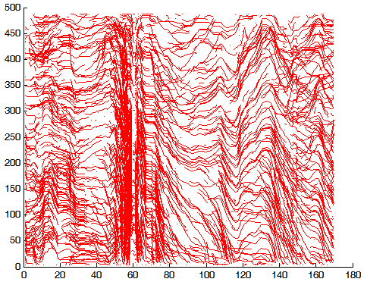
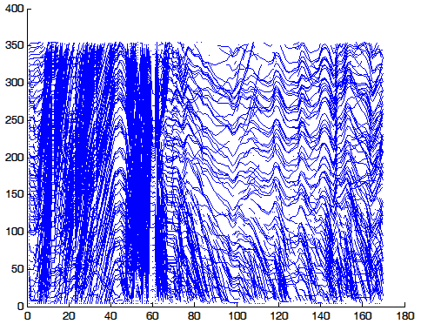
Approach
→ Particle Video
Uniform sampling (2’500/171’052)
Y : width
Y : height
X : frames number 1-169
X : frames number 1-169

Slide 15
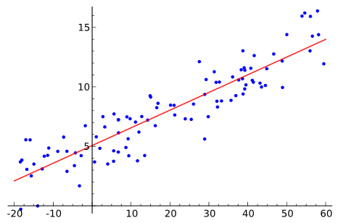
Approach
→ Particle Video → CCToolbox*
Tool for clustering curves using Matlab.
Need to convert to output of Particle Video in Matlab format.
Clustering parameters :
K = 3
Method = Linear Regression
wikipedia
* GAFFNEY, S. J. 2004. Probabilistic curve-aligned clustering and prediction with regression mixture models. Tech. rep., Ph.D. Dissertation, 2004. Laboratoire MAS.

Slide 16
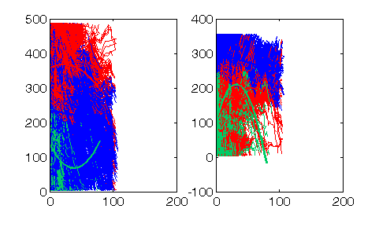
Approach
→ Particle Video → CCToolbox*
For 171’524 tracked points :
Width
Height

Slide 17
Approach
→ Particle Video → CCToolbox*
But,
Particle Video :
Way too slow to work with.
Need to reduce the number of tracking points.
Too much parameters to tune to be right.
CCToolbox :
How to find K ?
Conclusion : would need too much time to get it right.

Slide 18
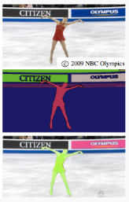
Approach
→ Graph-based video segmentation*
Idea :
Segment objects
Use the optical flow to find the speed of the objects
Remap the time
* GRUNDMANN, M., KWATRA, V., HAN, M.,ANDESSA, I. A. 2010. Efficient hierarchical graph-based video segmentation. In IEEE CVPR, 2141–2148.
http://www.cc.gatech.edu/cpl/projects/videosegmentation/

Slide 19
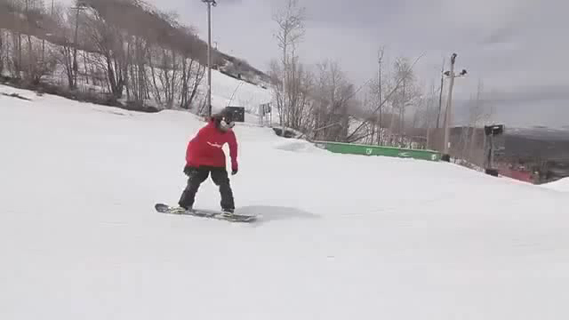
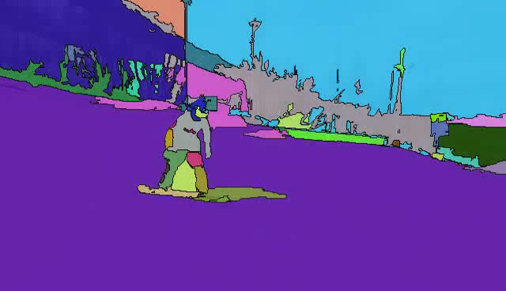
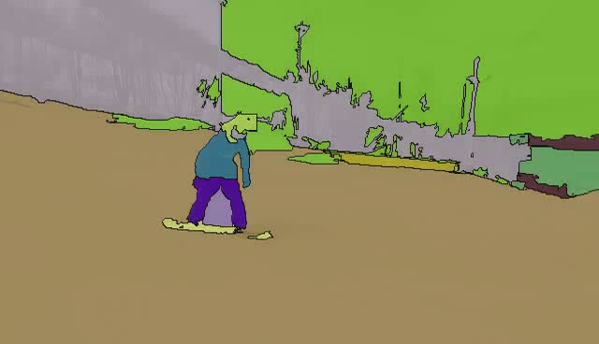
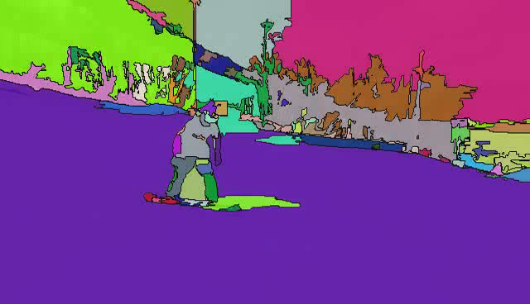
Approach
→ Graph-based video segmentation
Rendered movie at 90%, 70% and 50% of highest hierarchy level

Slide 20
Approach
→ Graph-based video segmentation
Advantages :
+ seems to work very well
+ output is a xml file with all the levels
+ fast
Disadvantages :
No framework, only a web interface
need to provide a hierarchy level for the optimal settings
Could have been the approach taken.

Slide 21
Approach
→ Own solution
Idea :
Use directly the information of the optical flow to determine the dynamism.
In short, we want to have a number that quantify the motion between two consecutive frames.
Draw a graph of the motion over time.
Remap time accordingly.

Slide 22
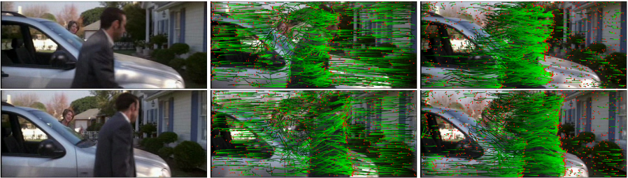
Approach
→ ω-flow* → Own solution
Problem : camera movement can be dominant
Solution : work with ω-flow :
Optical flow
ω-flow
* JAIN, M., JEGOU, H., AND BOUTHEMY, P. 2013. Better ex-ploiting motion for better action recognition. In CVPR, IEEE, 2555–2562
http://www.irisa.fr/texmex/people/jain/w-Flow/

Slide 23
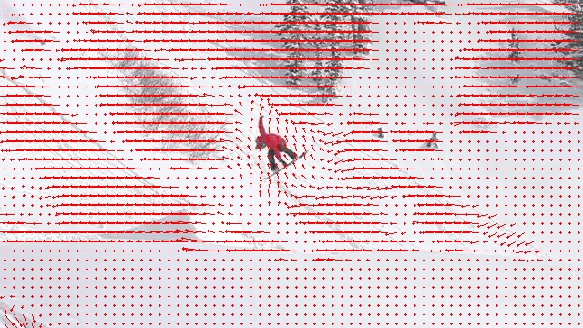
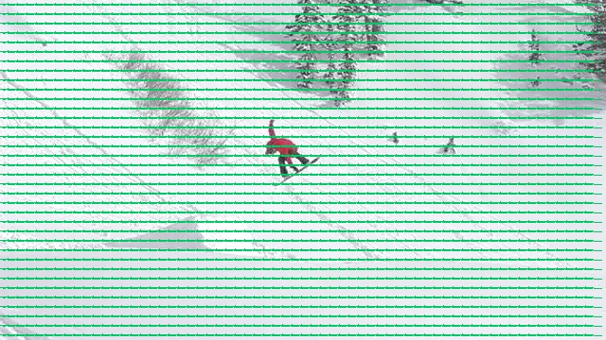
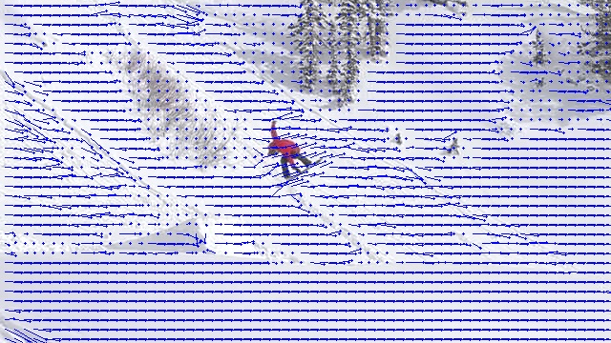
Approach
-
ω-flow
Optical flow
Affine flow
=

Slide 24
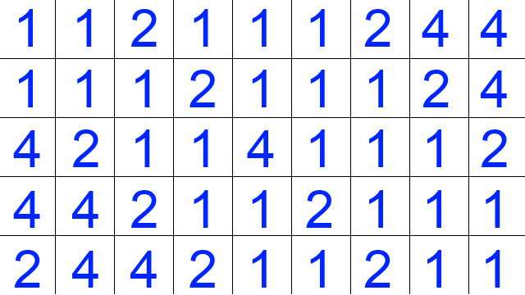
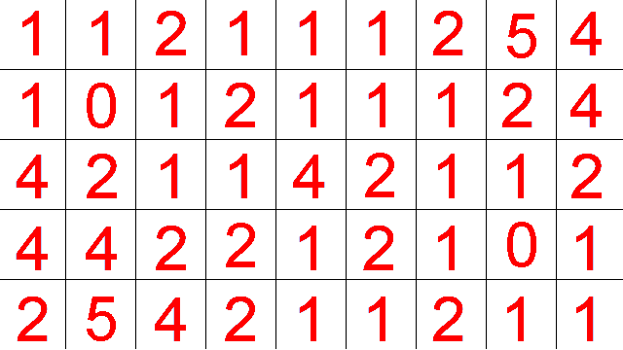
Implementation
→ Clustering
ω-flow
x
Displacement matrices
y

Slide 25
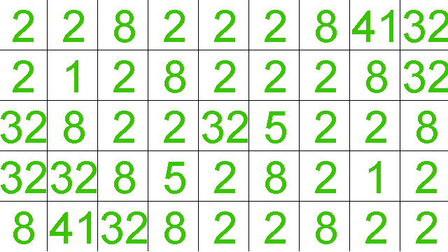
Implementation
→ Clustering
→ Clustering
Squared norms
Displacement matrices

Slide 26
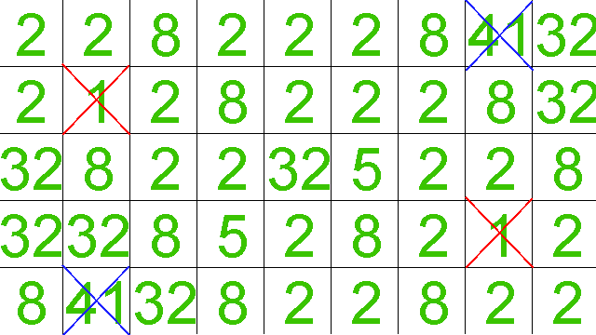
Implementation
→ Clustering
→ Clustering
Eliminate
-Background values
-Too high values
order
4.9 – 4.4 > 0.2
Parameters :
_minThreshold = 1.5
_maxThreshold = 40
_minDistInCluster = 0.2
_minClusterSize = 1
C1
C2
C3

Slide 27
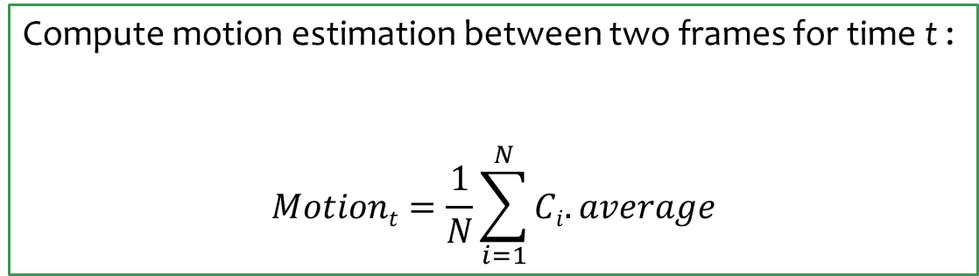
Implementation
→ Motion estimation
Compute motion estimation between two frames for time t :
$$Motiont=\frac{1}{N}\sum_{i=1}^{N}{Ci.average}$$

Slide 28
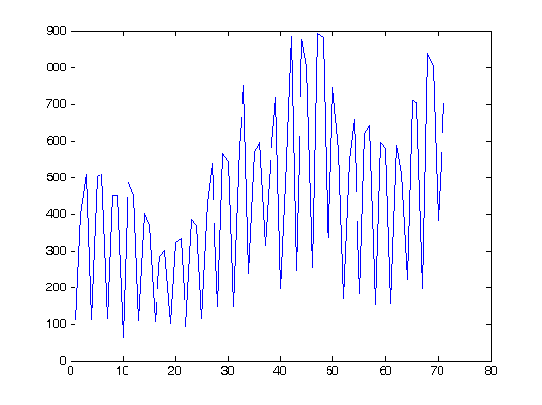
Implementation
→ Motion estimation
The optical flow values are not perfect and strongly depends on the video quality.
For example, MPEG-4 videos are decoded using I/P/B frames : some frames are drawn by interpolation. It is thus possible to have an in-between frame that is not exactly the one we expect (=not perfect as it was originally).
That’s why we can get this :
Motion estimation
Frame number (72)

Slide 29
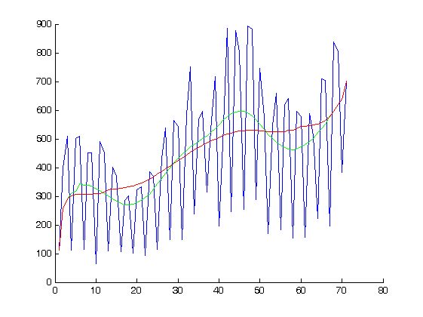
Implementation
→ Motion estimation
Need to smooth the data (running average) :
_window_size :
10
24
Motion estimation
Frame number (72)

Slide 30
Implementation
Load data into a timeline for time remapping.
Questions :
How to express the dynamism ?
How to present the data in an intuitive way ?
How to reencode the video based on the previous representation ?

Slide 31
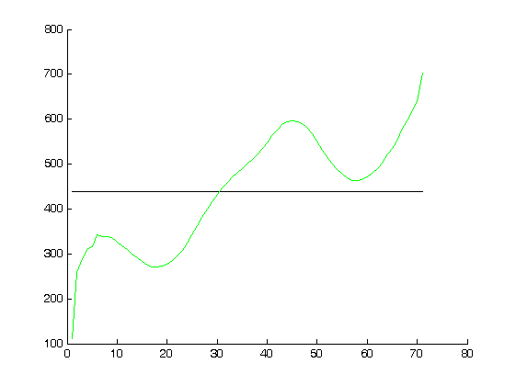
Implementation
→How to express the dynamism ?
Compute the mean μ of the data set.
Compute the ratio relatively to the average.
Represent the data with the help of a spline.
Motion estimation
μ
Frame number (72)

Slide 32
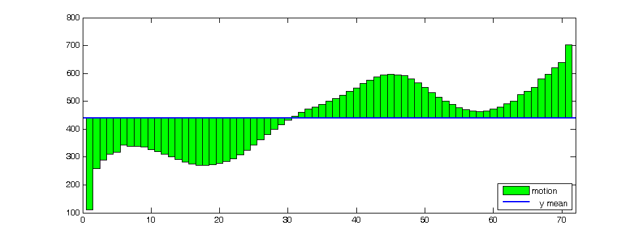
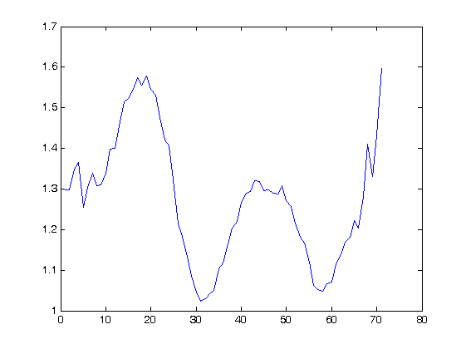
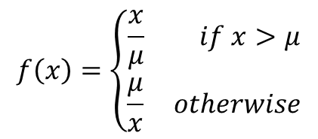
Implementation
Compute the mean μ of the data set.
Compute the ratio relatively to the average.
Represent the data with the help of a spline.
$$f\left(x\right)=\left\{\begin{aligned}\frac{x}{μ} if x>μ \\ \frac{μ}{x} otherwise\end{aligned}\right.$$

Slide 33
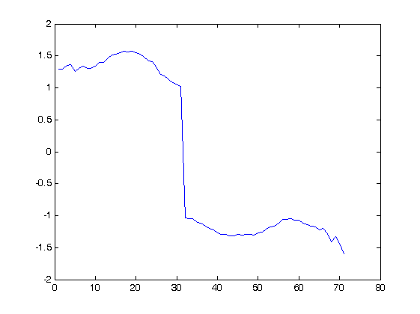
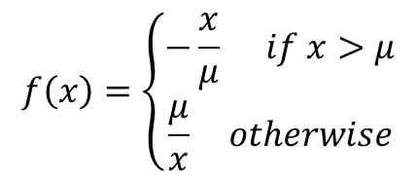
Implementation
Compute the mean μ of the data set.
Compute the ratio relatively to the average.
Represent the data with the help of a spline.
$$f\left(x\right)=\left\{\begin{aligned}−\frac{x}{μ} if x>μ \\ \frac{μ}{x} otherwise\end{aligned}\right.$$

Slide 34
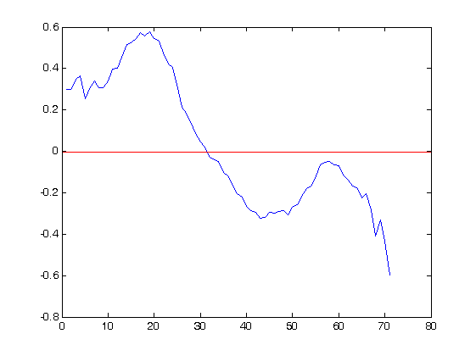
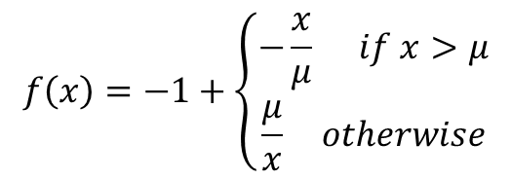
Implementation
Compute the mean μ of the data set.
Compute the ratio relatively to the average.
Represent the data with the help of a spline.
$$f\left(x\right)=−1+\left\{\begin{aligned}−\frac{x}{μ} if x>μ \\ \frac{μ}{x} otherwise\end{aligned}\right.$$

Slide 35
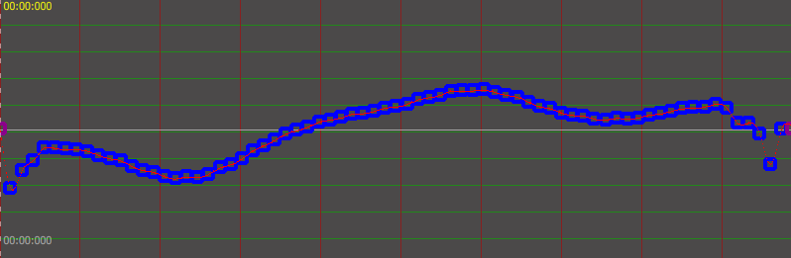
Implementation
→How to print the data ?
Compute the mean μ of the data set.
Compute the ratio relatively to the average.
Represent the data with the help of a spline.

Slide 36
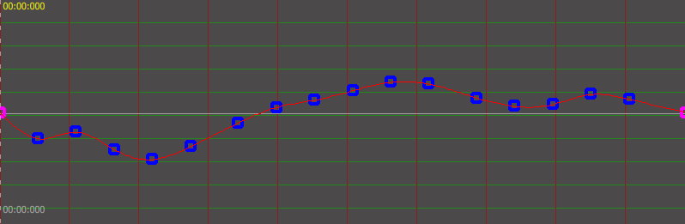
Implementation
→How to print the data ?
Compute the mean μ of the data set.
Compute the ratio relatively to the average.
Represent the data with the help of a spline.
Reduce the control points number using Least-Squares fitting.

Slide 37
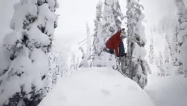
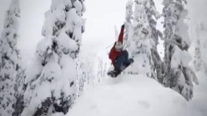

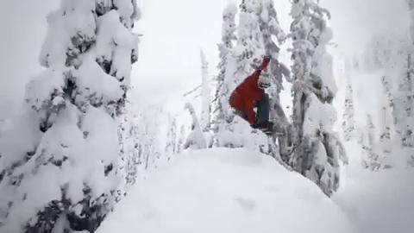
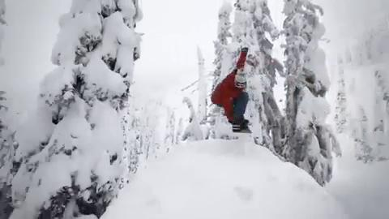
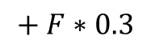
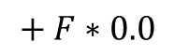
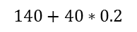
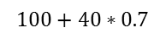
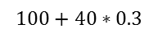
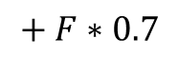
Implementation
→ How to get the interpolation factors ?
0.2
0.7
0.55
factor
0.5
f2
0.3
Accumulated ratio :
0.4
f1
f2
0.0
$$+ F∗0.0$$
$$+ F∗0.3$$
$$+ F∗0.7$$
0.3
f1
timeline
100ms
112ms
128ms
148ms
$$100+40∗0.3$$
$$100+40∗0.7$$
$$140+40∗0.2$$

Slide 38
Implementation
→ Interpolation factors

Slide 39

Implementation
→ Interpolation factors

Slide 40

Results

Slide 41



Results
minDistBetweenValues : 0.25, minClusterSize : 100, Background : 0.5
4x
minDistBetweenValues : 1.75, minClusterSize : 100, Background : 0.75

Slide 42

Results

Slide 43


Results
minDistBetweenValues : 0.5, minClusterSize : 10, Background : 0.5

Slide 44

Results
minDistBetweenValues : 0.5, minClusterSize : 10, Background : 0.5

Slide 45


Results
minDistBetweenValues : 1, minClusterSize : 100, Background : 0.1

Slide 46

Results
minDistBetweenValues : 1, minClusterSize : 100, Background : 0.1

Slide 47


Results
minDistBetweenValues : 0.5, minClusterSize : 10, Background : 0.5

Slide 48

Results
minDistBetweenValues : 0.5, minClusterSize : 10, Background : 0.5

Slide 49


Results
minDistBetweenValues : 0.5, minClusterSize : 10, Background : 0.5

Slide 50

Results
minDistBetweenValues : 0.5, minClusterSize : 10, Background : 0.5

Slide 51
Results
Conclusion :
Good result if the video
is in not too long (typically < 10sec)
optical flow of good quality
scene remains the same
Future work :
Extensible search of the optimal parameters.
More investigation on the meaning of the parameters.
Automatically cut long scenes in short sequences.
(Hire people to debug with me.)

Slide 52


Software

Slide 53


Software

Slide 54
Questions ?
Thank you !

